Slide 1
The Skeletal System
Support Systems
Unit 2

Slide 2
The Basic Functions of the Skeletal System
Hematopoiesis
The process of producing blood cells in the red bone marrow
Structure/Support
Provides a rigid framework that supports the soft tissues of the body and maintains the body’s shape

Slide 3
Functions cont.
Movement Facilitation
Bones serve as levers to convert muscular contraction to movement
Serves as a point of attachment for ligaments, tendons, and muscles
Mineral Storage
Bones store calcium in bone matrix

Slide 4
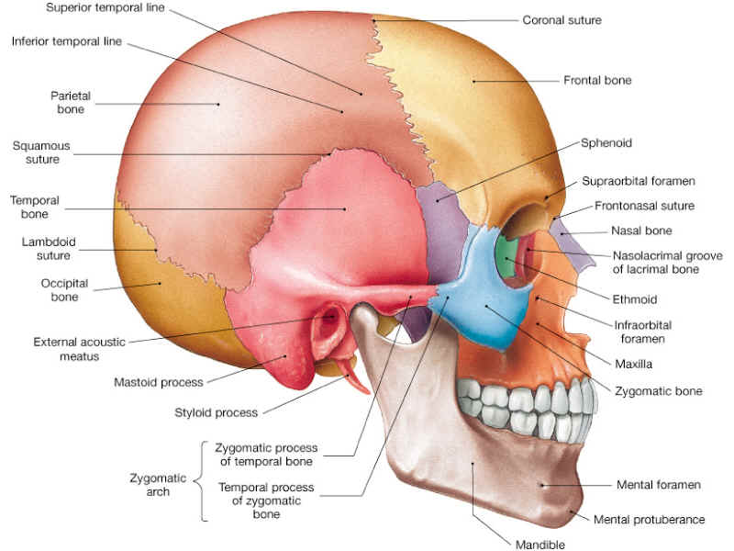
Bones of the Cranium

Slide 5
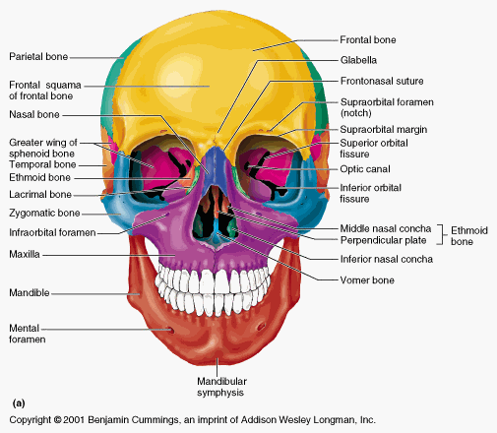
Bones of the Cranium

Slide 6
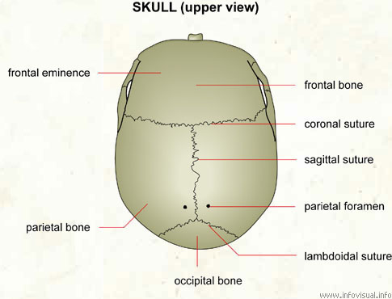
Bones of the Cranium

Slide 7
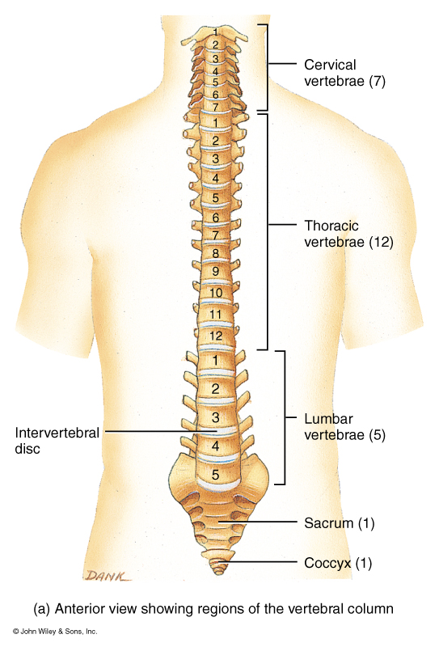
The Vertebral Column

Slide 8
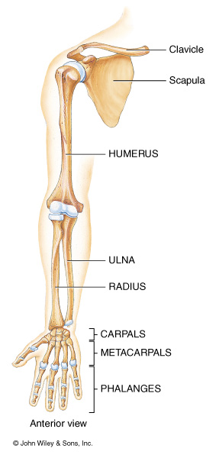
Bones of the Upper Extremities

Slide 9
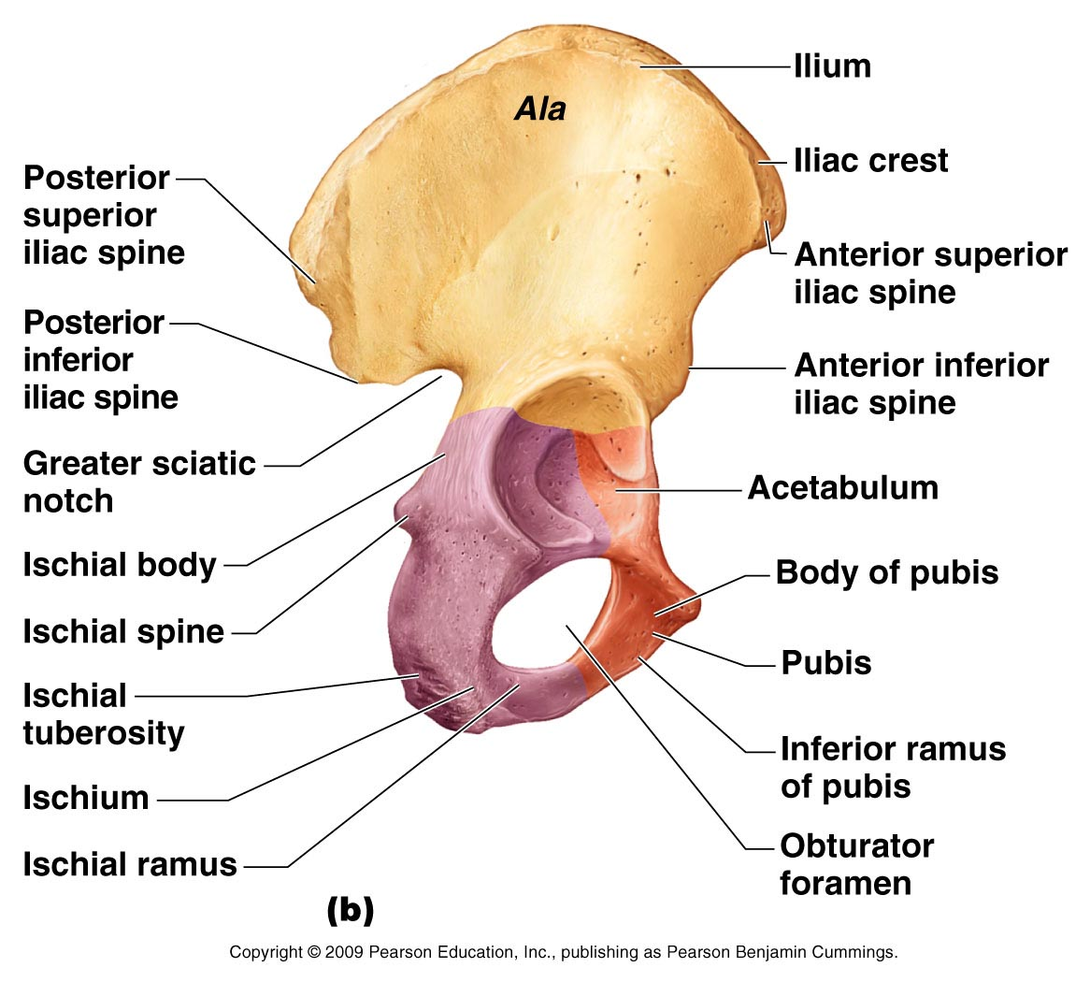
Bones of the Pelvis

Slide 10
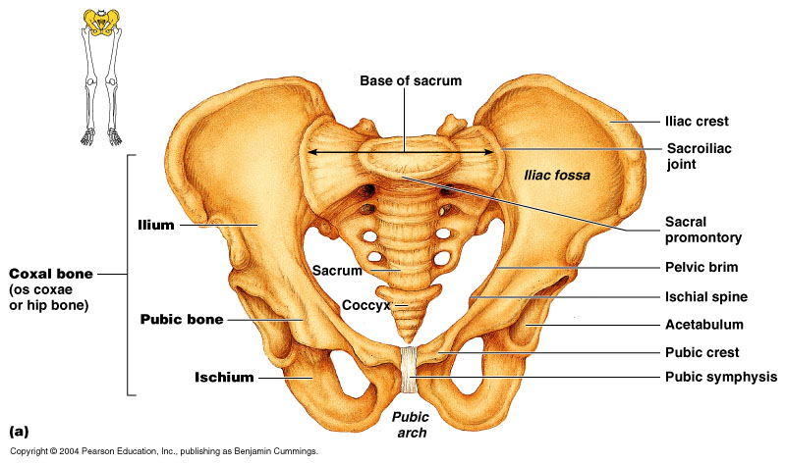
Bones of the Pelvis

Slide 11
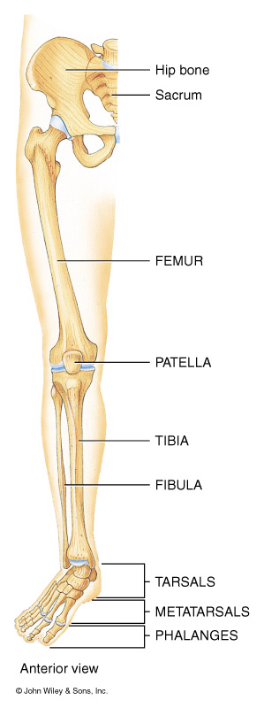
Bones of the Lower Extremities

Slide 12
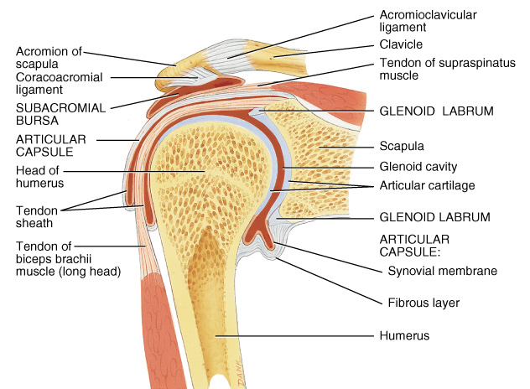
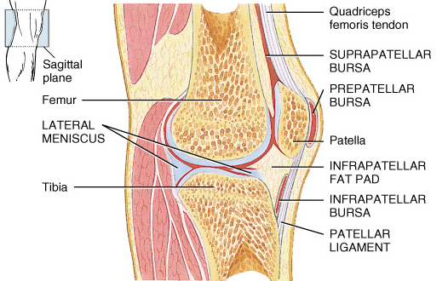
Joints
Definition
Any location where 2 bones meet
Types
Many joint are freely movable joints such as the shoulder, elbow, knee, etc.

Slide 13
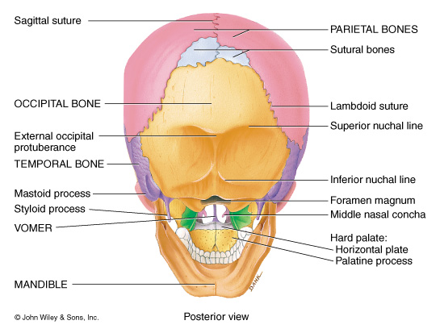
Joints
Types cont.
Some joints allow little to no movement such as the sutures of the skull

Slide 14
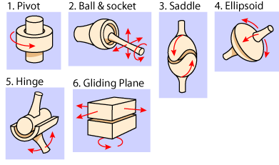

Slide 15
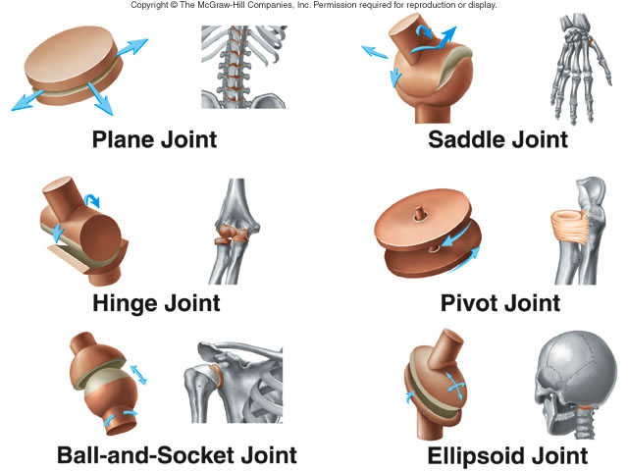

Slide 16
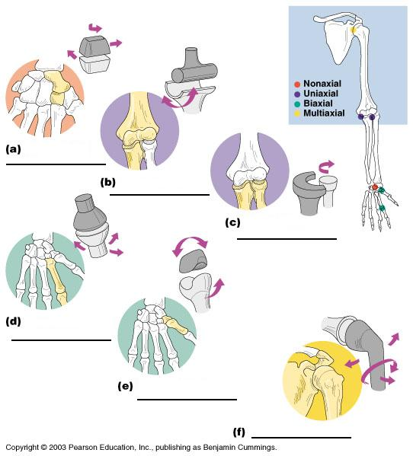

Slide 17
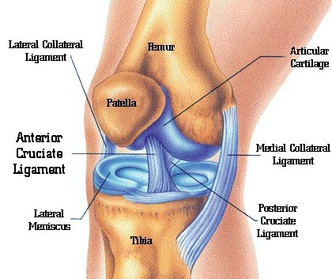
Ligaments
Ligaments attach bone to bones
They provide much of the support for our freely movable joints

Slide 18
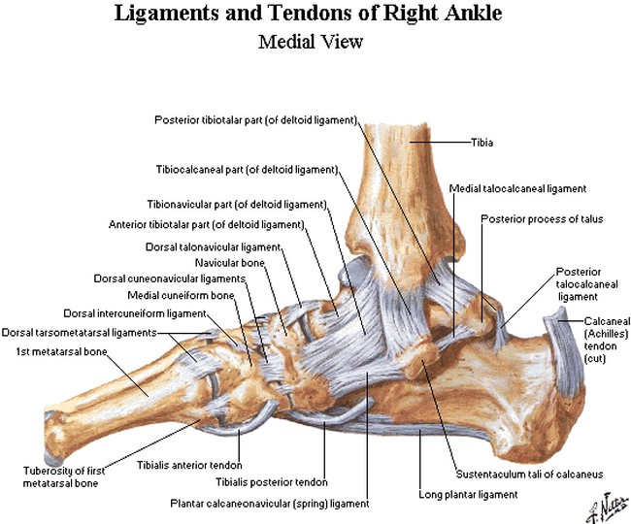
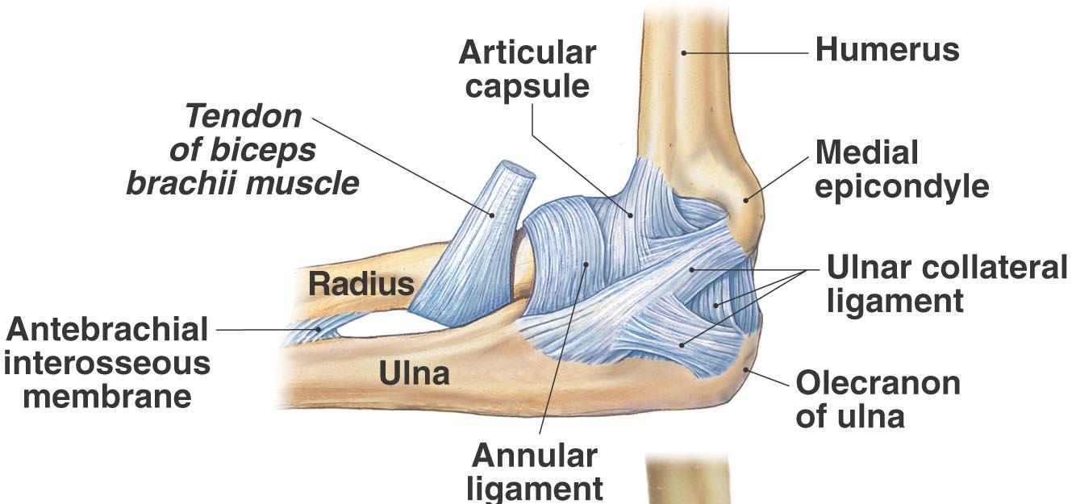

Slide 19
Fractures
Types of fractures
Closed or simple fracture
The bone is broken and the skin is intact
Open or compound fracture
The bone is broken and the skin is cut by the bone

Slide 20
Fractures

Slide 21
Fractures
Signs and symptoms
Pain upon palpation (touching)
Pain with movement
Obvious deformity
Caused by trauma
Treatment: Immobilization for 6-8 weeks
Compound fractures may require surgery

Slide 22
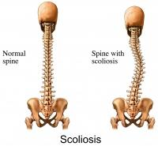
Scoliosis
Abnormal lateral curvature of the spine

Slide 23
Scoliosis
Signs & Symptoms
One hip or one shoulder higher than the other
Back pain
Muscle spasms
Cause
An imbalance of muscles
A leg length discrepancy
Treatment
Bracing, physical therapy, shoe inserts, surgery

Slide 24
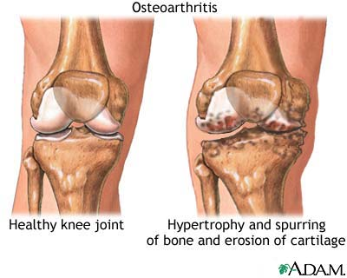
Osteoarthritis
Arthritis that is caused by the breakdown and loss of cartilage in the joints

Slide 25
Osteoarthritis
Cause: normal wear and tear on the joints
May be specifically causes by:
Obesity
Injury to a joint that is not cared for properly
Signs & Symptoms
Joint soreness, aching, stiffness, and swelling
Bone spurs may develop which increases pain and loss of motion
Treatment includes:
pain relievers, steroids, and surgical joint replacement

Slide 26
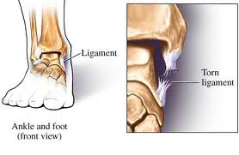
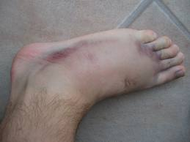
Sprain
The stretching or tearing of a ligament.

Slide 27
Sprain cont.
1st degree
The stretching of a ligament causing micro-tears in the tissue
2nd degree
A partial tear
3rd degree
A complete rupture
Signs & Symptoms include pain, swelling, joint laxity, instability
Treat with RICE

